Slide 1
Python functions

Slide 2
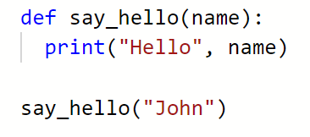
Function name
Parameters
Function body
Block of code (think back to the if statement

Slide 3

Function name
Parameters
Function body

Slide 4
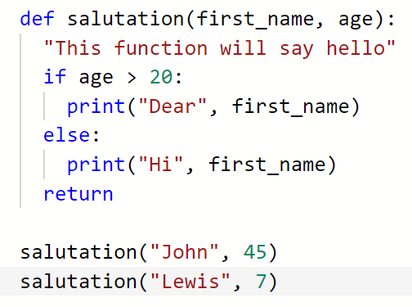
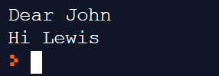
Comment
Return statement

Slide 5
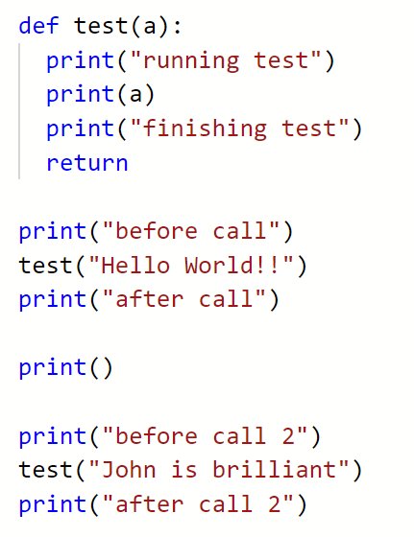
Order of execution

Slide 6
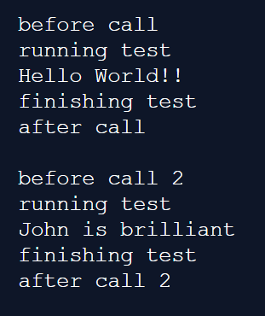
Order of execution

Slide 7
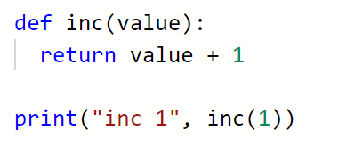

Slide 8


Slide 9

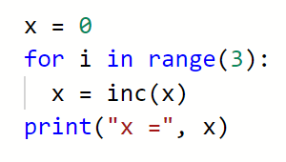
What will this output?

Slide 10


Slide 11

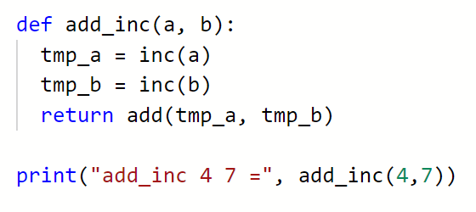
Calling functions from
within functions
Look

Slide 12

Calling functions from
within functions

Slide 13
Tasks
print( add(4,2) )
print( add(25, multiply(100, 50) )
Write a number of functions.
Adds two numbers and returns the result
Subtracts two numbers and returns the result
Divides two numbers and returns the result
Multiplies two numbers and returns the result
Create some code that uses your functions to solve:
4 + 2 10 * 2 10 - 100
4 - 3 20 / 5 11 * 3
25 + 100 * 50 Allow the user to enter values and choose the
square_number(a) operation (+,-,*,/)

Slide 14
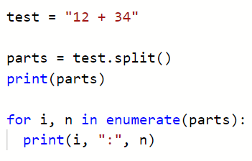
extension
Part 1:
E = mc²
Energy equals mass times the speed of light squared
Examples
m = mass in kg, e.g. 0.1
c = Speed of light = (300,000,000 m/s)^2
e = energy in joules
Part 2:

Slide 15

Modelling - vat
Let’s write a VAT function.
VAT in the UK is currently at 20%
Price of item + 20% = cost to customer
https://repl.it/@JohnGlazebrook/VAT
…. But VAT is tricky, for example children’s cars seats are 5%
https://www.gov.uk/guidance/rates-of-vat-on-different-goods-and-services

Slide 16
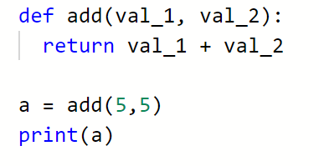


Slide 17
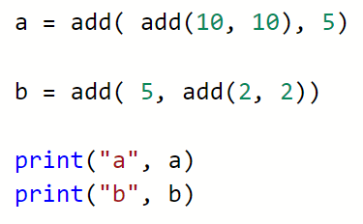
What will this output?

Slide 18


